Slide 1
Quality Review of Tax Return
Pub 4012 – Tab K
Pub 5101 – Intake/Interview And
Quality Review Training
Notes:
Release 2 Changes: The entire section on Conducting a QR Using the QR Print Set has been updated using the Jeremy Clark Core Exercise as the example. Slide 2 was added to show how this presentation is organized into four sections. A few minor format changes (bolding for emphasis, some clip art, etc.) were added
This presentation is designed for Instructors to develop Quality Review training to meet the needs of their various volunteers. The are far more slides than would be needed for certain volunteer groups. For example the first section may be useful for all volunteers***, including some Client Facilitators. Many districts conduct comprehensive training for Designated Quality Reviewers so perhaps the entire presentation could be adapted for that training.
***Note that the IRS requires all new volunteers to be trained using IRS Pub 5101 Intake/Interview & Quality Review Training. This can be accomplished with a classroom presentation or as self-study. Many districts conduct an orientation session for new volunteers and require the volunteers to review Pub 5101 and pass the required Intake/Interview & Quality Review Exam before attending the orientation or they present the Pub 5101 presentation at the orientation and administer the exam at that time.

Slide 2
Quality Review
This presentation is divided into four sections:
Principles of Quality Review (requirements and basic concepts of QR)
Conducting a Quality Review – One Example (using the QR Print Set)
QR Saves the Day (real life examples)
Quality Review Gold Standards
Notes:
This presentation has four sections. The presentation can be broken up and modified depending on the volunteers being trained.
Slides 4-26 provide a general overview of quality review requirements and concepts including the proper review of the Intake/Interview (I&I) Sheet
Slides 27-47 provide an example of how to conduct a quality review using the TaxSlayer QR Print Set. This section discusses the Quality Review only, it does not cover the final steps of finishing the return. The final steps vary from district to district and even site to site, so Instructors will need to develop training materials to present that information to their volunteers. See the notes on slide 27 – Instructors are encouraged to walk through this technique using a exercise return that volunteers have already prepared. Instructors can review slides 30-47 to observe the flow of this QR technique and prepare a set of notes to help them demonstrate use of the QR Print Set. This presentation demonstrates using the QR Print Set for the Clark Core Exercise in the 2018 NTTC Workbook.
Slides 48-64 Provide real life examples where a good QR “saved the day”
Slides 65-67 Provide the Gold Standard for Quality Review

Slide 3
Learning Objectives
Volunteers will:
Understand why quality review is important
Explore benefits of quality review
Review basic quality review process
Learn one QR technique using QR Print Set
Review real life examples illustrating value of a good QR
Discuss Gold Standards for Quality Review
Notes:
These learning objectives are presented in this entire presentation. Instructors will need to modify this slide as necessary depending on which section of this presentation they intend to present.

Slide 4
Principles of Quality Review
Accuracy is Job #1

Slide 5
QR = Accuracy – It’s a Fact
IRS reviews showed:
Volunteers who prepared returns using a complete Intake/Interview and Quality Review Process achieved 100% accuracy rate
Volunteers using an incomplete or non-existent Intake/Interview and Quality Review Process attained only 77% accuracy rate

Slide 6
Quality Review
IRS site reviews consistently report that quality review process has been a significant weak area
Deficiencies include:
Failure to refer to Intake Booklet (Form 13614-C)
Little or no engagement with taxpayer
Checking only if data are properly entered without evaluating overall return
Failure to inform taxpayer that return is their responsibility
Notes:
Quality review has been a consistent weak area every year in IRS Site Reviews

Slide 7
Requirements
While methodology may differ site-to-site, these rules apply to all:
ALL returns must receive a quality review by second certified Counselor
Quality review must be completed with taxpayer(s) present
Quality review takes place after return is prepared, but before taxpayer signs return
Notes:
Counselors must be certified for the specific tax year when reviewing prior year returns.

Slide 8
Quality Review Methods
Designated reviewer – preferred method
Designated quality reviewer
Dedicated to reviewing completed returns
Conducted at preparer’s computer or separate station
Peer review – volunteers exchange returns
Self-review – never acceptable
Notes:
Designated review can be done at the preparer’s computer or at a separate station as decided by the Local/Site Coordinator
However, it must always have the taxpayer present

Slide 9
What’s in it for…?
Who benefits from complete and accurate Quality Review?
Taxpayer
Volunteer
Site
AARP Foundation Tax-Aide

Slide 10
Benefits for the Taxpayer
Receive timely refunds
Prevent IRS notices/contacts
Calculation of correct tax, avoiding paying money back with interest and penalty
Receipt of all eligible credits or deductions
Increase confidence in return preparation process
Enhance understanding of return

Slide 11
Consequences of a Poor Quality Review
Notices from IRS are extremely stressful
No one enjoys being pen pals with IRS
Taxpayer hardship paying money back
Costly interests and penalties
Back taxes can damage taxpayer’s credit score
Missed eligible credits or deductions could be well needed money for taxpayer

Slide 12
Benefits for the Volunteer
Reduces anxiety knowing another volunteer “has your back”
Receiving feedback increases skills and builds confidence
Raises volunteer morale
Fosters teamwork

Slide 13
Benefits for the Site
Reduces e-file reject rates
Ensures compliance with Quality Site Requirements
Promotes good reputation with the public
Increases productivity, reduces rework (amended returns)
Improves volunteer confidence and retention
Gives taxpayers more confidence in site’s ability to prepare complete and accurate tax returns

Slide 14
Benefits for AARP Foundation Tax-Aide
Creates positive reputation and public confidence
Continued Congressional appropriation of grant funds
Maintains public perception of quality and value of Tax-Aide return preparation
Positive feedback from random audits by Treasury Inspector General and IRS ensure future support
Identify potential enhancements to software

Slide 15
Quality Review Process
Resource: Resource Guide Pub 4012 Tab K, the Basic Quality Review Process
The two most important elements of a quality review are taxpayer involvement and careful review of the Intake Booklet
Note: Part VIII – IRS Certified Volunteer Quality Reviewer Section is no longer included in Intake/Interview Form 13614-C

Slide 16
Quality Review Process
The process must include these elements:
Verify all issues on tax return are within Tax-Aide scope and within certification level and training of both volunteers
Verification that all required entries on Intake Booklet were completed
Notes:
The Quality Reviewer should make corrections on the Intake Form if there are any noted during the QR interview

Slide 17
Keys to an Accurate Quality Review
Involve the taxpayer(s)
Thorough review of Intake Booklet
Careful review of return PDF
All errors/deficiencies corrected
Compare with last year’s return (if available)

Slide 18
Involve Taxpayer
Establish rapport with taxpayer(s)
Include taxpayer in review process
Review any ‘issues’ that came up during preparation
Ask taxpayer(s) if they have any questions about the return
Ensure taxpayer understands that they are responsible for accuracy of return
Notes:
Introduce yourself and explain the quality review process to taxpayer

Slide 19
Intake Booklet
The only one who knows everything is the taxpayer
Review of Intake Booklet is the key to a good quality review
Site reviews consistently show that careful review of Intake Booklet result in accurate returns

Slide 20
Review Intake Booklet
Preparer noted any changes, new information, clarifications, etc. on Intake Booklet?
Parts I & II
Is Filing Status correct and most advantageous for taxpayer?
Are all dependents claimed as Qualifying Children or Qualifying Relatives as appropriate?
Were dependent questions (gray section) properly answered?
Notes:
Have note pad available to take notes on specific items to check like capital loss carryover.

Slide 21
Review Intake Booklet
Part III - Income
Tax documents match appropriate checked boxes
All “Unsure” or unmarked boxes resolved
All tax documents accounted for and entered
Ask taxpayer if there is any other income not reflected by Intake Booklet or tax documents

Slide 22
Review Intake Booklet
Part IV – Expenses
Only qualifying expenses entered on return
All available adjustments to income included
Appropriate deductions (standard or itemized and/or qualified business income) used to compute taxable income
All available credits applied to reduce total tax
Credits make sense (EIC, AOC, CTC, etc.)

Slide 23
Review Intake Booklet
Part V – Life Events
Confirm all events affecting return
Pay attention to estimated tax payments
Check for capital loss carryover
Often least understood by taxpayers and overlooked by Counselors
Infrequently seen items sometimes out-of-scope
Did taxpayer receive a letter from IRS?
Notes:
Note that “Did you receive a letter from the IRS?” has been moved to this section to be more prominent

Slide 24
Review Intake Booklet
Part VI – Health Care Coverage
Minimum essential coverage properly reflected for each person
Appropriate exemptions identified and recorded on Form 8965
Any shared responsibility payments accurate and appropriate
If Form 1095-A present … entered correctly for marketplace coverage
Premium tax credits correctly reconciled, if applicable, on Form 8962

Slide 25
Review Intake Booklet
Part VII – Additional Information
Note any direct deposit/direct debit
Check bank account information
Check notes that have been added
Create additional notes if applicable

Slide 26
Bottom Line
Quality review is more than a proofreading exercise
QR ensures an accurate return
QR provides the highest refund (or lowest amount due)
Notes:
26

Slide 27
Conducting a Quality Review One Example
Using the QR Print Set
Notes:
Volunteers have various methods for conducting a quality review. The following slides provide an example of one QR method using the TaxSlayer QR Print Set. This presentation walks through the QR using the Jeremy Clark Core Exercise from the 2018 NTTC Workbook as an example. NOTE: While slides 30-46 could be used to demonstrate the method of QR using the QR Print Set, Instructors could also have the volunteers open an existing exercise return that they have completed and walk through the QR steps illustrated in this example. In this way the volunteers can compare the taxpayer documents provided in the exercise to the forms in the print set.
Instructors can review the slides in this section to observe the flow of the quality review and then could construct a script or set of notes to help guide the class through the QR using an exercise that they have completed while the Instructor projects the TaxSlayer PDF on the screen.

Slide 28
Conducting a Quality Review (part 1)
Methods include:
Reviewing the QR Print Set (recommended)
Retracing preparer’s steps
Reviewing Summary/Print and linking to input screens
QR on computer rather than printed return
Incomplete/missing forms are apparent
Ease of updating errors
Saves paper and ink/toner
Notes:
There is no one-size-fits-all process. For example, if the return is a very simple one, retracing the preparer’s steps is probably the most efficient and quickest way to review the return. Conversely, for a return that has multiple W-2s and/or 1099-Rs, it may be more effective use the QR Print set
The following slides demonstrate one method for conducting a quality review

Slide 29
Conducting a Quality Review (part 2)
Techniques vary from one Counselor to another
No one-size-fits-all technique
QR may use one or a combination depending on nature of return
Following is an example of using the QR Print Set
Notes:
There is no one-size-fits-all process. For example, if the return is a very simple one, retracing the preparer’s steps is probably the most efficient and quickest way to review the return. Conversely, for a return that has multiple W-2s and/or 1099-Rs, it may be more effective use the QR Print set
The following slides demonstrate one method for conducting a quality review

Slide 30
Return to be reviewed – Jeremy Clark
This example uses the 2018 NTTC Workbook Core Exercise Jeremy Clark
MFJ with 2 dependent children
Two W-2s
1099-DIV
Unemployment
Child Care Payments
Notes:
The following slides illustrate the steps of a quality review using the QR Print Set

Slide 31
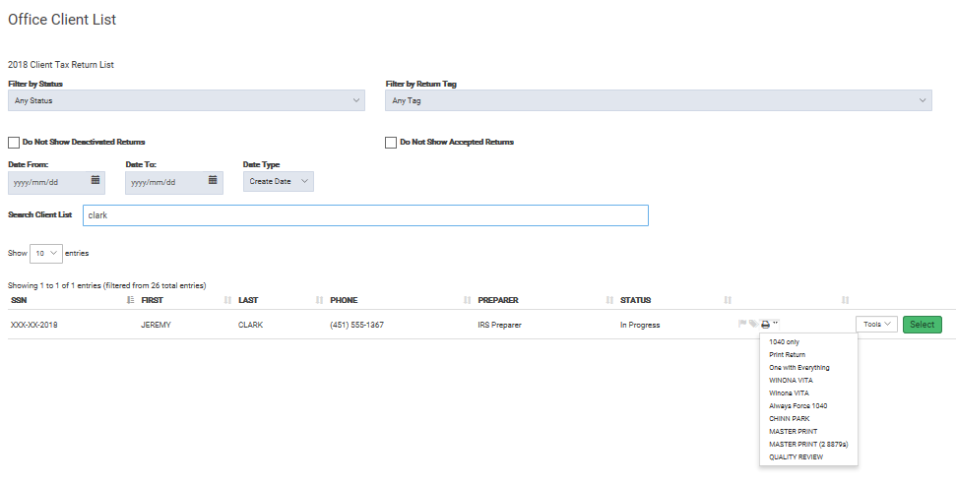
Quality Review Return PDF
Select Quality Review
Notes:
One way to conduct QR is to select drop down arrow and then select [Quality Review] pdf from Office Client List without having to open return
Have a note pad available to list any items that need to be corrected with the return is opened
Can also leave the PDF open in one window
And open the return in another window

Slide 32
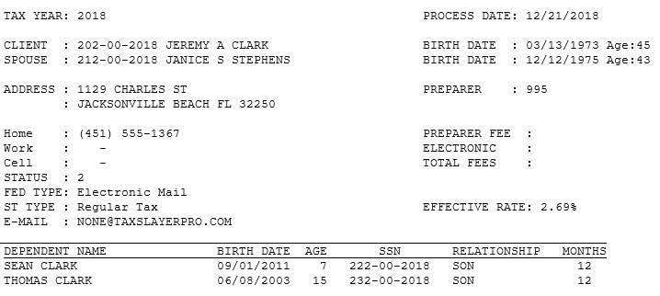
Personal Information Summary
Most if not all of the entries in the Personal Information Section can be verified here
Notes:
The taxpayer’s personal information can be checked using this summary page in the print set. Reviewing this page with the taxpayer while examining the Intake/Interview Sheet provides high confidence in accuracy of basic information
In some cases, the Quality Reviewer may need to verify certain check boxes such as disabled, full-time student, etc. but even some of those can be verified in other places such as Schedule EIC and on page 1 of the 1040.

Slide 33
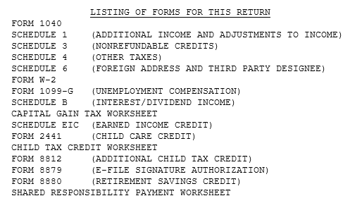
Listing of Forms
The Quality Reviewer can get a good feel for the return here and see if the list matches the documents the taxpayer has provided
Notes:
This PDF page provides a useful summary which should match with the taxpayer’s documents

Slide 34
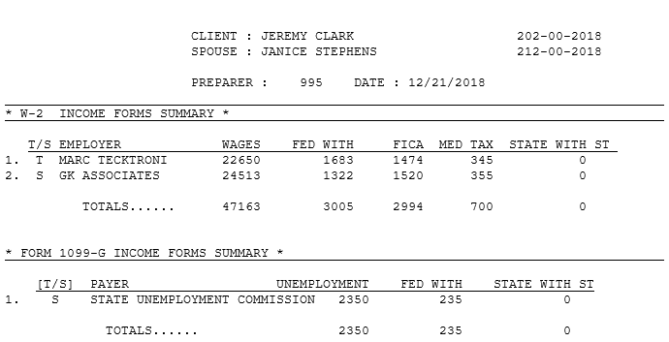
Verify Unemployment
Form 1099-G will not be displayed – you can verify the information here. Social Security benefits from Form 1099-SSA are also displayed on this screen
Notes:
A copy of any W-2s, 1099Rs, and 1099-MISC will appear in later pages of the print set. 1099-G and Form SSA-1099 information can be verified on this page

Slide 35
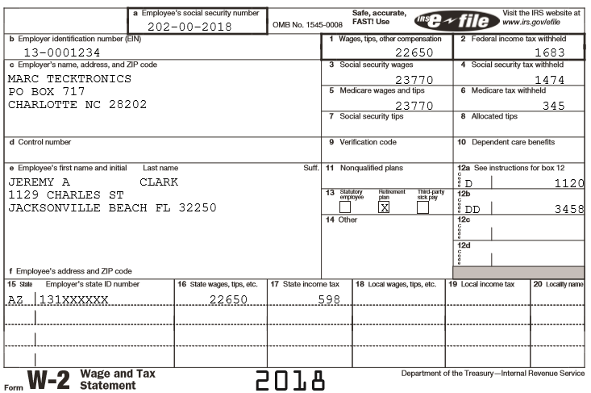
Verify W-2 information
Code D may mean a retirement Savings Credit is present which should be verified
Code DD can indicate that ACA requirements have been met which should be verified
Does the address match the taxpayer’s W-2?
Notes:
Verify W-2 information
Quality Reviewers should not only verify the accuracy of the data entries, but also should think about what else the form may telling them (e.g. Could there be a Retirement Savings Credit, a Childcare Credit, HAS adjustment, etc.

Slide 36
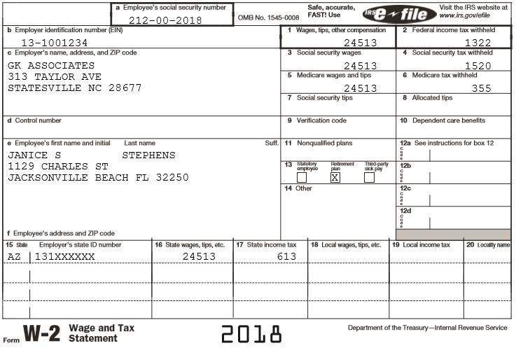
Verify W-2 information
Second W-2 – again review all information matches paper document
Notes:
Verify W-2 information

Slide 37
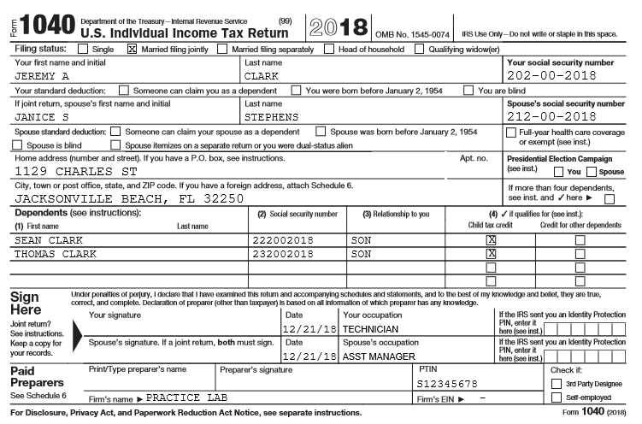
Review Form 1040
Can verify some check boxes here
Healthcare Section needs review
Verify occupations and IPPIN
Notes:
Can review 1040 form here
This is a good point to compare with last years return and to see if taxpayer(s) have any questions
For 2018 tax year will have to review the applicable schedules

Slide 38
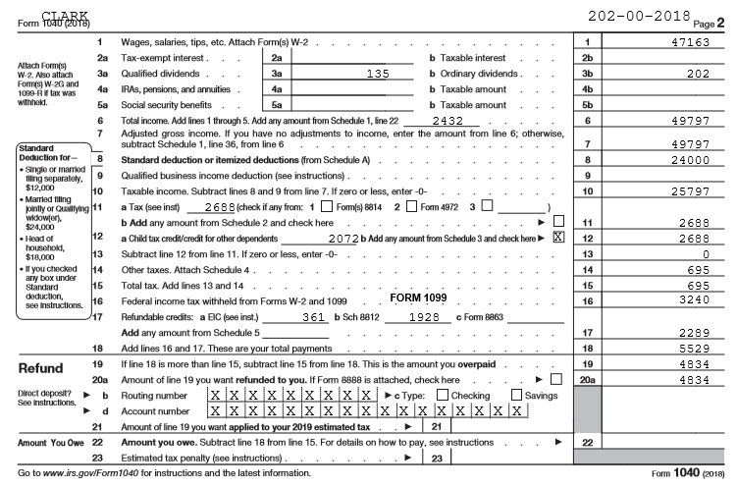
Page 2 of Form 1040
Is the Standard Deduction correct?
Do the CTC and ACTC look correct for two children under age 17?
Verify Bank Information
For many of our taxpayers most if not all of their income (wages, pensions, Social Security, Interest, and Dividends) will be shown here
Notes:
Basic income is shown (lines 1 – 5) along with capital gain distribution and unemployment (line 6) from Schedule 1
Do the Child Tax credits look correct?
Child tax credit is shown on line 12 along with Foreign Tax Credit from Schedule 3
Janice’s SRP is shown on line 15 from Schedule 4
Note that most of the Refundable Credits we were used to seeing in the payments section (EIC, ACTC, AOC) are now shown here on line 17.

Slide 39
Review Form 1040 Numbered Schedules
Schedule 1 – Additional Income and Adjustment to Income
Schedule 2 – Tax
Schedule 3 – Nonrefundable Credits
Schedule 4 – Other taxes
Schedule 5 – Other Payments and Refundable Credits
Schedule 6 – Foreign Address and Third Party Designee
Notes:
Note that these schedules contain all the items that were on prior years’ long form 1040 with the same line numbers
Returning volunteers should all be familiar with all the line items only the packaging is different
Note that as of December 24th of 2018 TaxSlayer did not yet include all of these schedules in the QR Print. They intend to do so. If not, the Master Print set contains them.

Slide 40
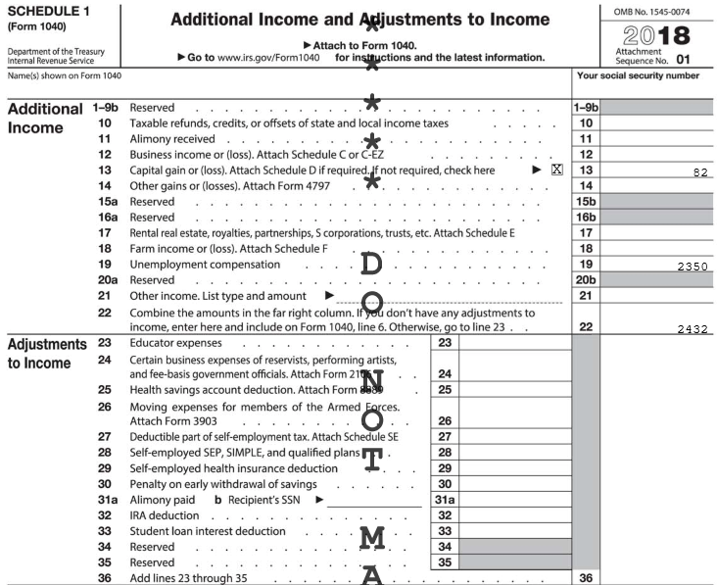
Review Schedule 1
Lines 23,27,30,32, and 33 are most common and line 29 is now in scope
Verify other income items and any adjustments (Note line numbers are the same as old 1040)
Notes:
Capital gain distribution from 1099-DIV
Unemployment from spouse’s 1099-G
Note that self-employment from Schedule C, Rent from Schedule E, and Other Income (gambling, cancelation of debt, jury duty, poll worker, etc.) would all show up here

Slide 41
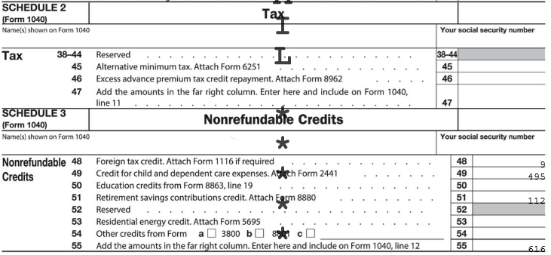
Review Schedules 2 & 3
One Marketplace ACA Issue can be verified here
Do non-refundable credits agree with taxpayer documents and situation? (Note one non-refundable credits (CTC) is shown on page 2 of the 1040)
Notes:
Note that Marketplace Insurance issues can show up in multiple places.
Foreign Tax credit from the 1099-DIV, Child Care Credit from Form 2441, and Retirement Savings Credit from Form 8880
The non-refundable Child Tax Credit and Credit for Other Dependents shows up on 1040 page 2 Line 12

Slide 42
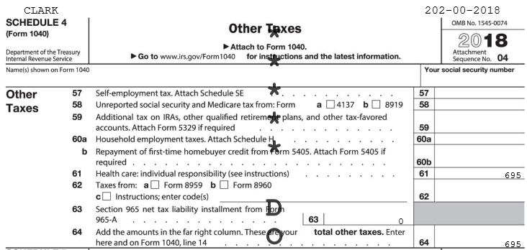
Review Schedule 4
Janice had no MEC or exemption
Lines 57 and 59 are most common
Notes:
Note the line numbers remain the same as the old 1040 which may be helpful in comparing this return to a prior year.

Slide 43
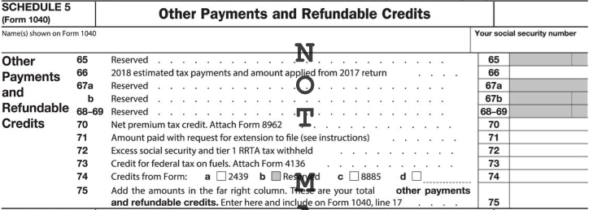
Review Schedule 5
One more Marketplace ACA Issue can be verified here
Estimated payments can be verified here
Note that the Refundable Credits we are most used to (EIC, ACTC, and Education) are shown on the new 1040 Page 2
Notes:
Most of the information that was in this section on the old 1040 is now moved to the new 1040 page 2

Slide 44
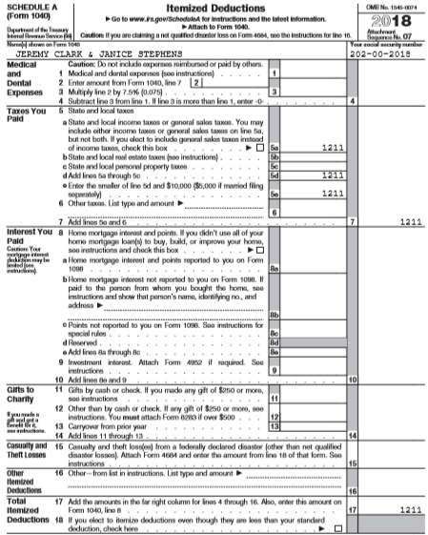
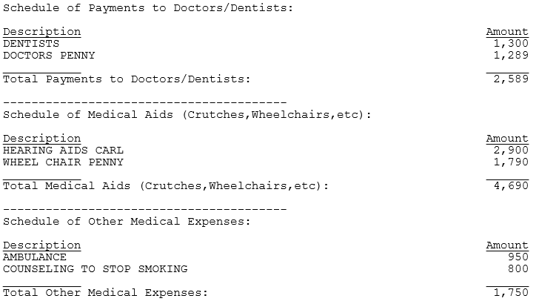
Review Schedule A
Itemized deductions can be verified here and there will also be lists with more detailed entries (medical, charity, etc.) on separate pages of the QR Print Set see example below
Notes:
Instructors should stress to volunteers that using the “scratch pads” in TaxSlayer when entering itemized deductions can greatly aid the Quality Reviewer in check these entries by allowing them to review them here rather that going back into the return to view the data entry pages.

Slide 45
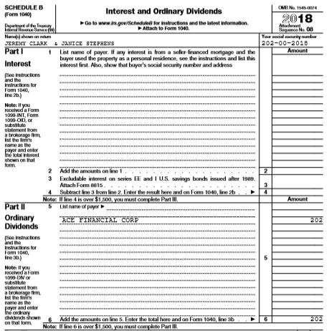
Review Schedule B
Qualified Dividends are shown on page 2 of the 1040
Notes:
The names of the financial institutions on Interest and dividend statements can be checked on Schedule B. Amounts of qualified dividends, and tax exempt interest can be checked on page 2 of the 1040.

Slide 46
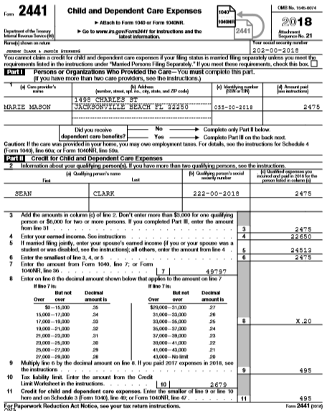
Review Form 2441
Carries to Schedule 3
Notes:
Ensure that the amount paid to child care provider is correct and not modified because of employer paid benefits shown in box 10 on a W-2 (a common mistake)

Slide 47
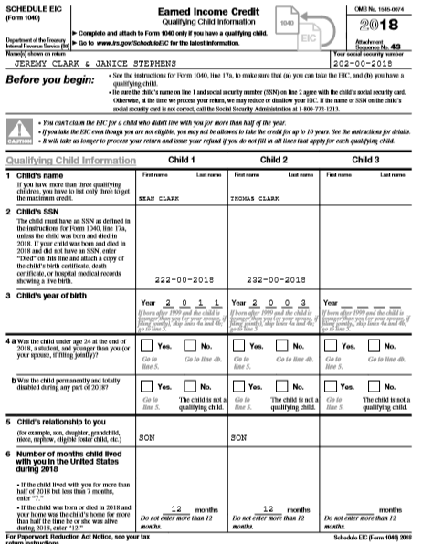
Review Schedule EIC
Are all appropriate Qualifying Children entered for EIC?
Checked boxes in the Personal Information Section may be verified here in some cases

Slide 48
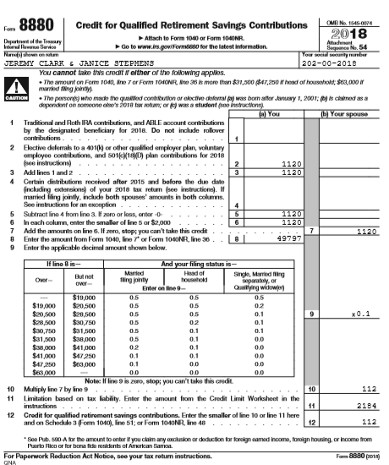
Review Form 8880
Did any pension distributions need to be subtracted (e.g. military or plans where employee voluntary contributions were not allowed)?
Jeremy had a code D on his W-2. Carries to Schedule 3

Slide 49
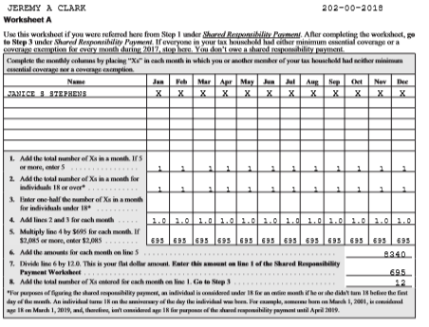
Review SRP
Are the proper months indicated for SRP? Also verify again that no exemptions apply

Slide 50
Summary
The QR Print Set is a useful tool for verifying the accuracy of the return
The need to examine individual data entry pages inside the return can be minimized if not eliminated altogether
Counselors can assist the Quality Reviewer by using the “scratch pads” in TaxSlayer when appropriate to provide more detail

Slide 51
QR Saves the Day
Real Life Cases
Notes:
The following slides describe real scenarios seen at tax sites where the Quality Review “saved the day”
They illustrate that a good QR is not just a proof reading exercise, but needs to be a critical look at the return and continued dialog with the taxpayer to ensure the accuracy of the return

Slide 52
QR Saves the Day
Quality review not just a proof-reading exercise
A good QR may involve some detective work
There often more to the story
Following cases are real life examples
QR “saved the day”
Notes:
The Quality Reviewer is not only a certified Counselor they are also an expert, teacher, mentor, teammate and more

Slide 53
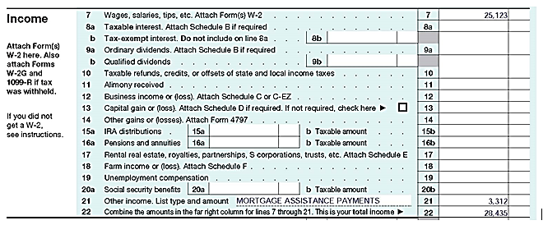
Case 1 – Just because there is a form………..
Page 1 of Form 1040 reviewed in the QR Print Set
Reviewer noted taxpayer provided the Form 1098-MA
Payments not taxable, but Form 1098-MA is out-of-scope!
What do you think?
Notes:
In this case the preparer did not consult the Tax-Aide Scope Manual and just assumed this was income that should be entered on the return

Slide 54
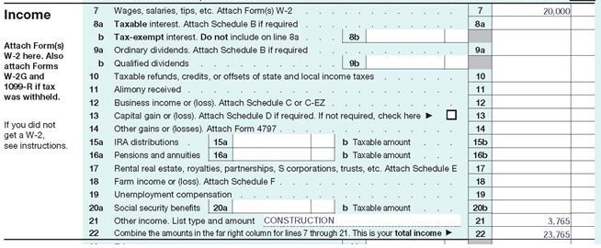
Case 2 – Accepting things at face value………..
Page 1 of Form 1040 was being reviewed in the QR Print Set – and the reviewer noted this
The taxpayer had a 1099-MISC with entry in Box 3
What do you think?
Taxpayer worked part-time for a contractor doing construction work
What probing questions should be asked?
Notes:
Employers do not always enter income in the right place on a 1099-MISC a conversation with the taxpayer is essential

Slide 55
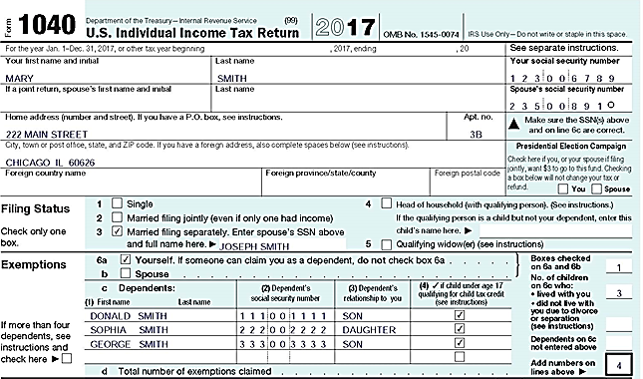
Case 3 – Taxpayers don’t know all the rules
Page 1 of Form 1040 was being reviewed in the QR Print Set – and the reviewer noted this
>Taxpayer filed MFS in the past
>Last year separated
>Lived apart the last 8 months of the year
>Children lived with her
>Met requirements for HoH
What do you think?
What probing questions should be asked?
Notes:
In this case the preparer simply went with what the taxpayer said – “We have always filed Married Filing Separately”

Slide 56
Case 4 – Why the QR does an interview
Part II, line 2, of the Intake Booklet handed to the QR
Single return claiming no dependent or nondependent:
Notes:
In this case the taxpayer assumed that the brother would have no effect on their return because the brother provided his own support

Slide 57
Case 4 – The rest of the story
Same intake sheet after the QR updated the Intake Booklet:
Taxpayer, single, worked only part-time (wages $21,355) cared for disabled brother
Brother is qualifying child for the EITC
EITC went from zero to $2,925

Slide 58
Case 5 – It’s not always that simple
Part III of the Intake Booklet handed to the quality reviewer:

Slide 59
Case 5 – The rest of the story
Return looked so easy: only single guy age 28, one W-2 for $28,000 wages. Here is the QR interview:
QR: So, you just had one job last year?
Taxpayer: I did some seasonal work delivering packages during the holidays, but didn’t get a tax form and I don’t think that they took out much in taxes anyway.
QR: You need to report that income, too. Maybe you can get access to the W-2 online?
Taxpayer: Maybe. I think it went to my dad’s house. Do I have to have that form?

Slide 60
Case 5 – The rest of the story (part 2)
Return looked so easy: only single guy age 28, one W-2 for $28,000 wages. Here is the QR interview: (part 2):
QR: Yes. We can hold your return and you can come back another day. Was there any other income?
Taxpayer: Last summer I worked construction for about a week and it paid well. But they just gave me cash. I earned $1,200.
QR: That needs to be reported, too. Did you have any expenses related to the construction work?
Taxpayer: What do you mean?

Slide 61
Case 5 – The rest of the story (part 3)
Return looked so easy: only single guy age 28, one W-2 for $28,000 wages. Here is the QR interview: (part 3):
QR: Did you have to buy any tools or equipment?
Taxpayer: Naw, they had everything. But they did make me buy a special safety hard hat. I may still have the receipt.
QR: When you come back with that W-2, I need to know about that construction job, how much you were paid and the amount of any expenses

Slide 62
Case 5 – The Updated Intake Booklet
Here is the updated Intake Booklet:

Slide 63
Case 5 – The end of the story
Return put on hold
Return prepared two weeks later
Two W-2s and a Schedule C
Form 1099-MISC for that construction work
Mailed to his dad’s house

Slide 64
Case 6 – Leave no question unanswered
Part VI of the Intake Booklet handed to the quality reviewer:
Same Intake Booklet after the quality reviewer update:

Slide 65
Case 6 – The rest of the story
Taxpayer received IRS letter for a prior year about claiming her grandchildren as dependents and as qualifying children for the EITC and child tax credit
Taxpayer needed help responding to IRS inquiries
Referred to a Low Income Taxpayer Clinic (LITC)
Completed Form 8862, Information to Claim Certain Refundable Credits After Disallowance to file with 2017 return

Slide 66
Case 7 – We’ve all seen this one
Part II, line 2, Intake Booklet handed to the quality reviewer (2017 return prepared with single filing status):
Intake Booklet after the quality reviewer’s interview:
Notes:
In this case the taxpayer came in in March but neglected to read “As of December 31, 2017 were you….”

Slide 67
Case 7 – The rest of the story
Uh oh! Back up the truck and start this return over
Taxpayer married at the end of tax year 2017
Taxpayer decided to talk to her ex
They filed a joint return
one last time

Slide 68
Quality Review Gold Standards
The methods may vary
but the goal is an accurate return!

Slide 69
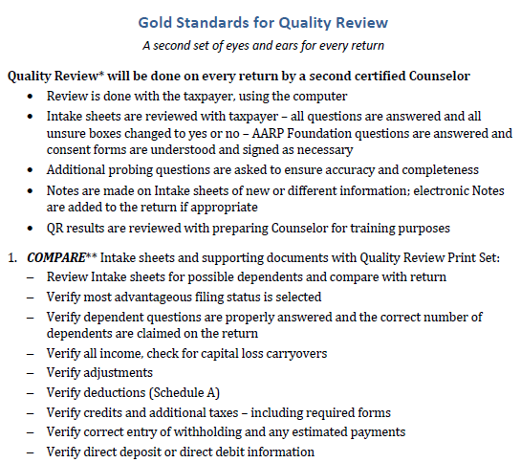
QR Gold Standard (available in Portal Library)

Slide 70
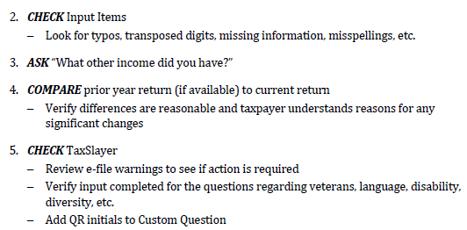
QR Gold Standard (con’t)

Slide 71
Quality Review
Questions?
Comments…

